Slide 1
Evaluating NER

Slide 2
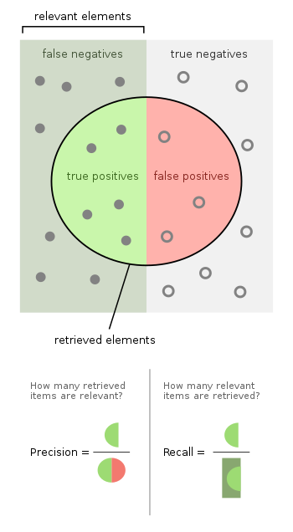
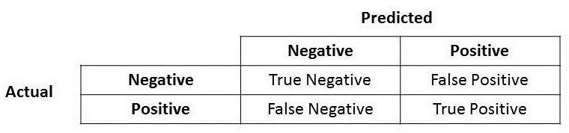
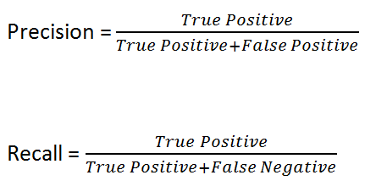
Some metrics

Slide 3
Some metrics
Precision
true positive results divided by the number of all positive results
How precise/accurate is your model for predicting positive
Use when there is a high cost for False Positive
Recall
the number of true positive results divided by the number of all samples that should have been identified as positive
Percentage of the actual positives we predict correctly
Use when there is a high cost for False Negative
F1
The harmonic mean of Precision and Recall
Looking at the balance between Precision and Recall

Slide 4


Harmonic Mean
The harmonic mean can be expressed as the reciprocal of the arithmetic mean of the reciprocals of the given set of observations.
Example, the harmonic mean of 1, 4, and 4 is:
For the special case of just two numbers:

Slide 5
Why the harmonic mean?
To explain, consider for example, what the average of 30mph and 40mph is? if you drive for 1 hour at each speed, the average speed over the 2 hours is indeed the arithmetic average, 35mph.
However if you drive for the same distance at each speed -- say 10 miles -- then the average speed over 20 miles is the harmonic mean of 30 and 40, about 34.3mph.
The reason is that for the average to be valid, you really need the values to be in the same scaled units. Miles per hour needs to be compared over the same number of hours; to compare over the same number of miles you need to average hours per mile instead, which is exactly what the harmonic mean does.
Precision and recall both have true positives in the numerator, and different denominators. To average them it really only makes sense to average their reciprocals, thus the harmonic mean.
Notes:
The harmonic mean can be expressed as the reciprocal of the arithmetic mean of the reciprocals of the given set of observations.

Slide 6
Note
The precision-recall curve, and thus the F-score, explicitly depends on the ratio of positive to negative test cases.
This means that comparison of the F-score across different problems with differing class ratios is problematic
Only compare F-scores on the same dataset

Slide 7
What does that mean for NER?
What is a False Positive?
We identify a named entity that is not a named entity
What is a False Negative?
We incorrectly say an actual named entity is not a named entity
Which is worse?
Notes:
Answer: It depends

Slide 8
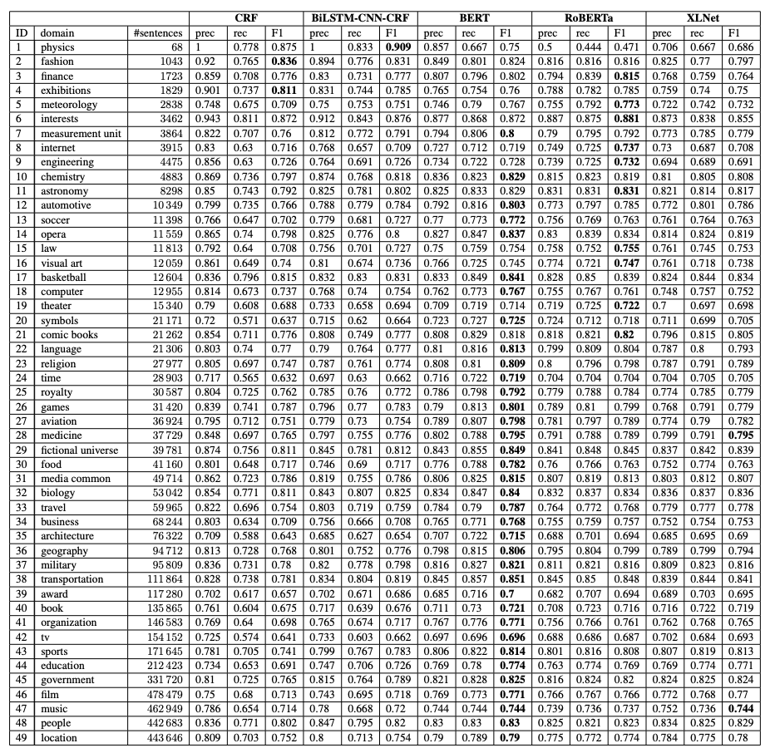

Slide 9
Evaluating Pretrained Transformer-based Models on the Task of Fine-Grained Named Entity Recognition
Cedric Lothritz et al. –
Proceedings of the 28th International Conference on Computational Linguistics, pages 3750–3760 Barcelona, Spain (Online), December 8-13, 2020
The term ”Fine-Grained Named Entity Recognition” (FG-NER) was first coined by Fleischman and Hovy (2002). It describes a subtask of NER, where the objective remains the same as standard NER, but where the number of entity types is considerably higher. In extreme cases, FG-NER models such as the fine-grained entity recognizer (FIGER) (Ling and Weld, 2012) are able to distinguish between more than 100 distinct labels.
…
We limited the number of entity types per domain to the top 50 and, if necessary, added a miscellaneous type as a catch-all for all remaining named entities.

Slide 10
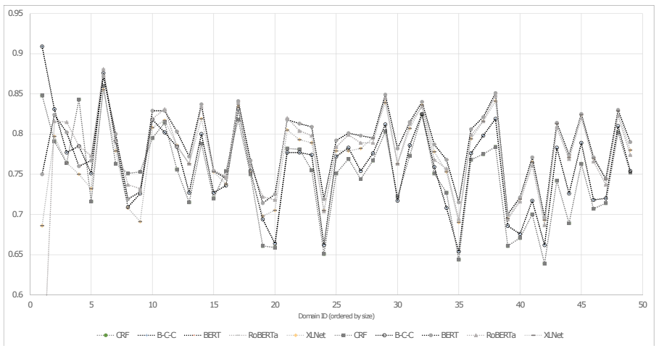
F-1 Scores for each of the models on each of the datasets

Slide 11
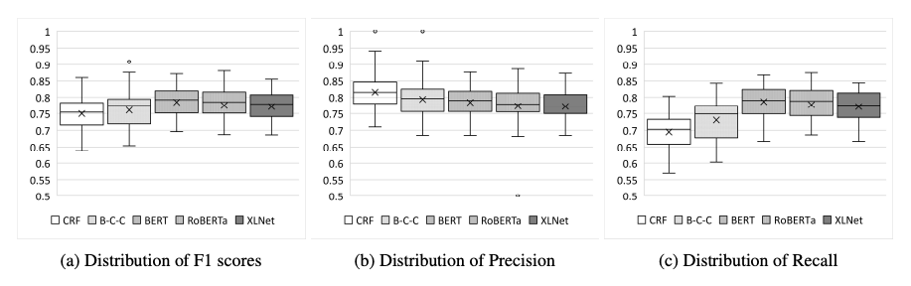

Slide 12
Take-Home Messages: To summarise, the transformer-based models do indeed outperform the BiLSTM-CNN-CRF model with regards to F1 score, with BERT yielding the highest results overall. The simple CRF model achieved the best performance in terms of precision, while performing the worst in terms of recall. Compared to both CRF and BiLSTM-CNN-CRF, the transformer-based models achieved significantly higher recall scores. Furthermore, we observe significant discrepancies when applying the models to different domains. Moreover, when a model is performing better (resp. worse) on one domain, the other models also perform better (resp. worse). This suggests that while transformer-based models can indeed bring significant performance improvements, their language understanding may not be outstandingly different. Indeed, if they were clearly different, we could have reasonably expected to note different patterns in the performance for the FG-NER task (i.e., they would not systematically perform well/badly for the same domains).

Slide 13
Question
Are all false positives / false negatives equal?
What about
Bill vs New York City Library
Does F1 account for this difference at all?
It may depend on how we line up the prediction and actual values
But is New York City Library worth 4 times as much as Bill?

Slide 14
More Questions
What factors of the datasets significantly influence NER performance?
How do these factors influence the choices of models?
Does a worse-ranked model outperform the best ranked model in some aspects and how do datasets influence the choices of models?

Slide 15
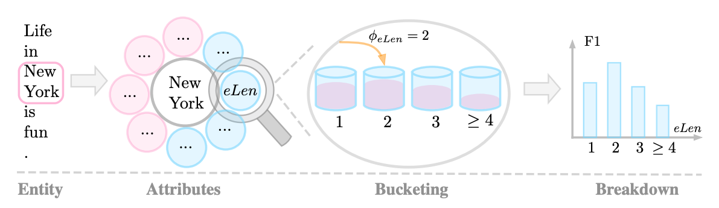
Proposed answer methodology
Split dataset by various attributes and then bucketize and analyze performance of the algorithm in the buckets.
Interpretable Multi-dataset Evaluation for Named Entity Recognition, Jinlan Fu et al.

Slide 16
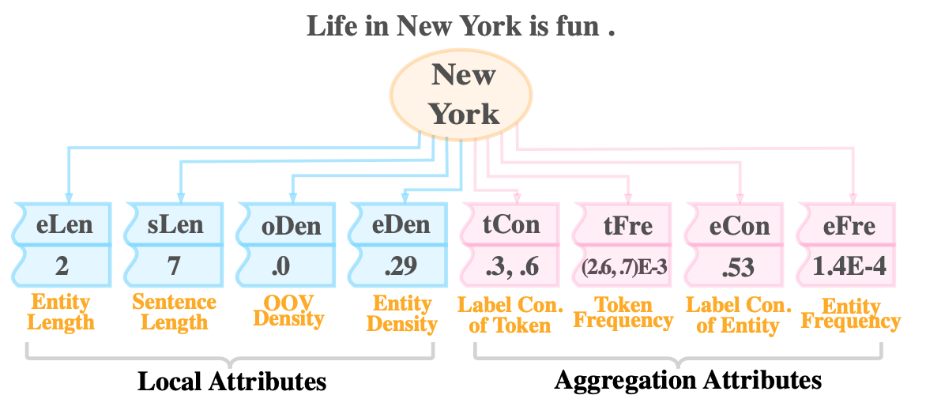
Attributes
OOV Density – density of words outside of training set
Con. - Consistency

Slide 17
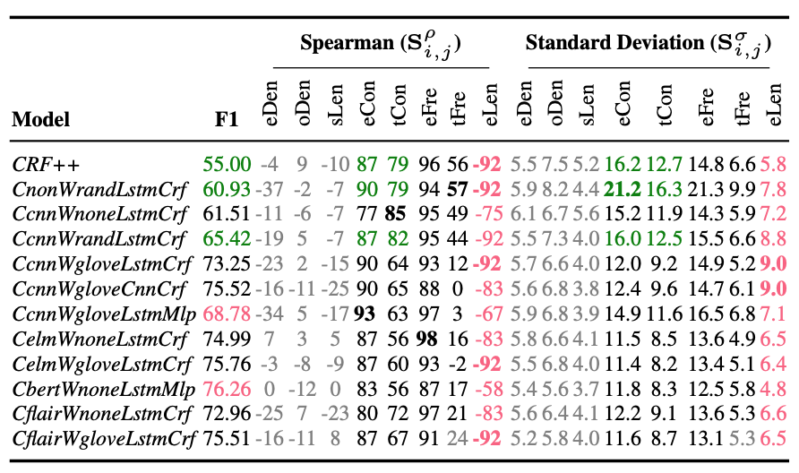
Green - character-level encoder plays a major role in generalization to entities with low label consistency
Pink - The influence of entity length varies greatly between different decoders.
Entity length is strongly negatively correlated with the performance of models,
which means the performance of the model will drop with the entity length increasing.

Slide 18
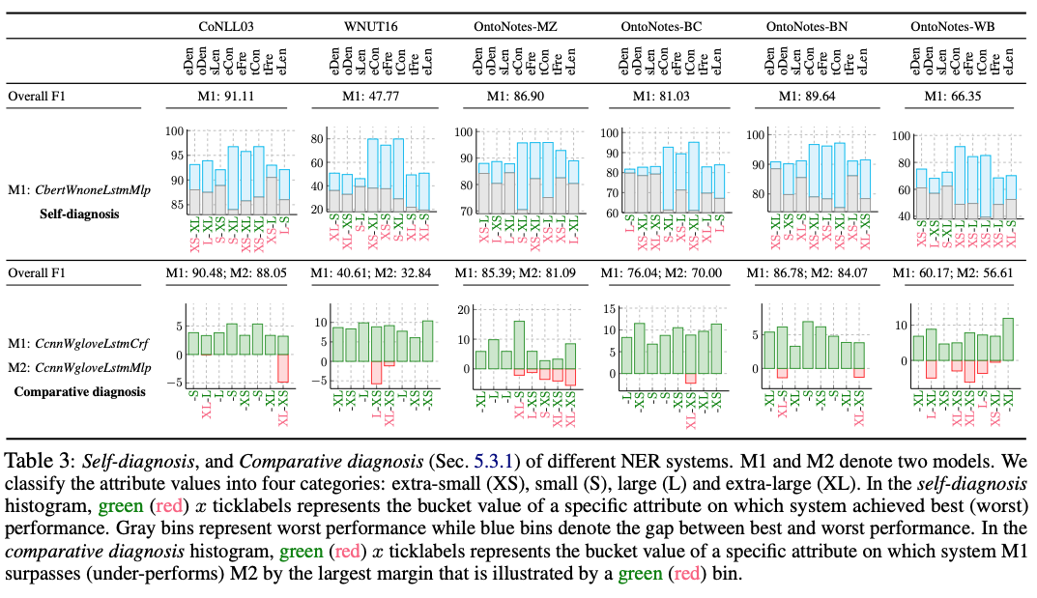
Notes:
BERT –
We observe that large performance gaps (tall blue bins) commonly occur for the attributes label consistency and entity frequency, and the worst performance on these attributes was obtained on buckets with low consistency (eCon, tCon:XS/S) and low entity frequency (eFre:S).
This reveals that it is still challenging for contextualized pre-trained NER systems to handle entities with lower label consistency and lower entity frequency.
CRF vs MLP
Introducing a CRF achieves larger improvements on long entities once the dataset has a lower label consistency
using the CRF layer does not exhibit significant gains (even worse than models without CRF) on longer entities

Slide 19
http://explainaboard.nlpedia.ai/

